Slide 1

Ozone and Environment
Notes:
EGEE 102 - Energy Conservation and Environmental Protection
8. Ozone and the Environment

Slide 2
Stratospheric Ozone
Layer Destruction

Slide 3
Ozone
O₃
a gas composed of three atoms of oxygen
bluish gas that is harmful to breathe
Nearly 90% of the Earth's ozone is in the stratosphere and is referred to as the ozone layer
Ozone absorbs a band of ultraviolet radiation called UVB

Slide 4
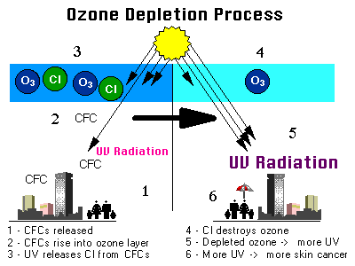

Slide 5
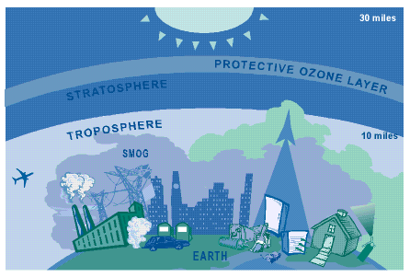

Slide 6
Ozone-Depleting Substance(s) (ODS):
CFCs,
HCFCs,
halons,
methyl bromide,
carbon tetrachloride, and
methyl chloroform.
Notes:
EGEE 102 - Energy Conservation and Environmental Protection
8. Ozone and the Environment

Slide 7
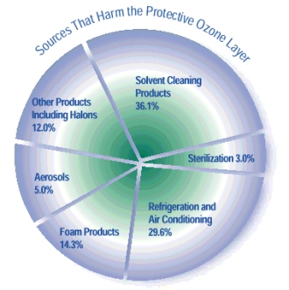
Various sources

Slide 8
Effects of OLD
-- Skin Cancer (melanoma and nonmelanoma)
-- Premature aging of the skin and other skin problems
-- Cataracts and other eye damage
-- Immune system suppression

Slide 9
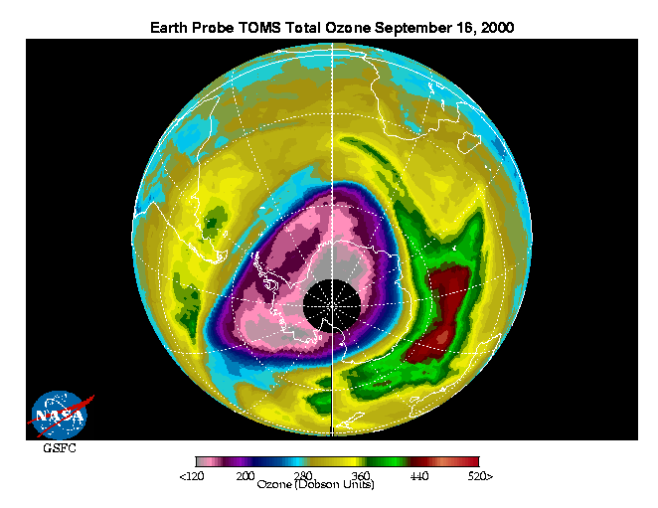
The Antarctic Ozone Hole
The ozone hole is defined as the area having less than 220 dobson units (DU) of ozone in the overhead column (i.e., between the ground and space).

Slide 10
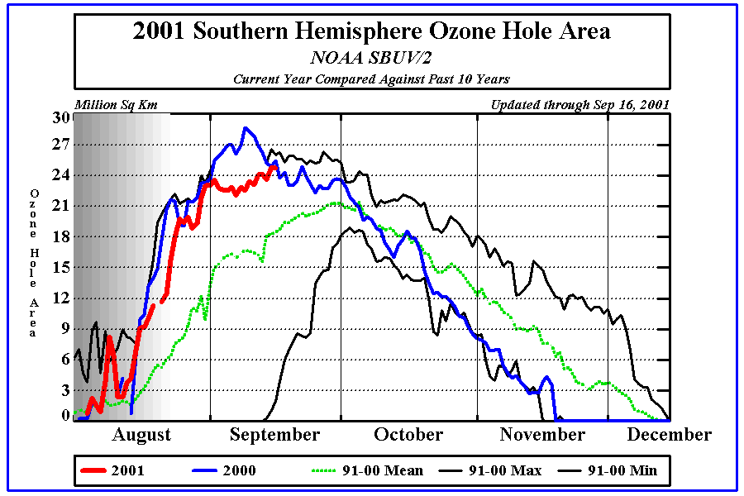

Slide 11
What can we do?
Make sure that technicians working on your car air conditioner, home air conditioner, or refrigerator are certified by an EPA approved program to recover the refrigerant (this is required by law).
Have your car and home air conditioner units and refrigerator checked for leaks. When possible, repair leaky air conditioning units before refilling them.

Slide 12
Ground Level
Ozone
Formation

Slide 13

Photochemical Smog
O₃
CO
PAN
Haze
NO₂
CO
HC
NO
CO, RH
6:00AM 12NOON 3:00 PM

Slide 14
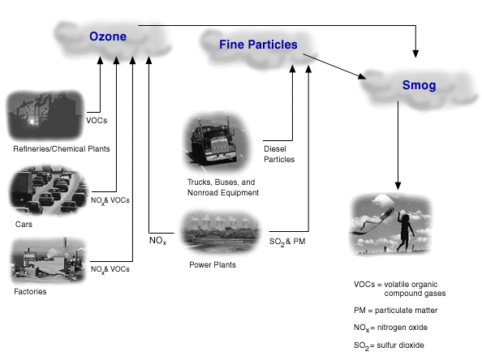
Smog Sources

Slide 15


